Slide 1
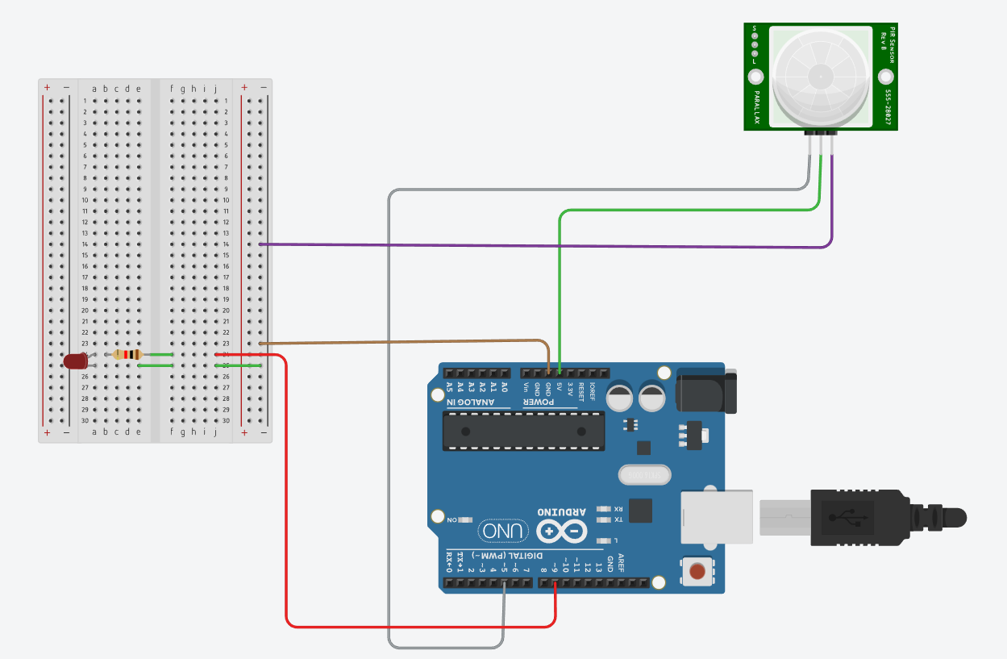
Motion Detection System

Slide 2
Motion Detection System
Detects movement of humans or animals in an area.
Uses a PIR sensor to sense motion.
Arduino processes the sensor signal.
Can trigger alarms, lights, or displays.
Used in security and automation systems.

Slide 3
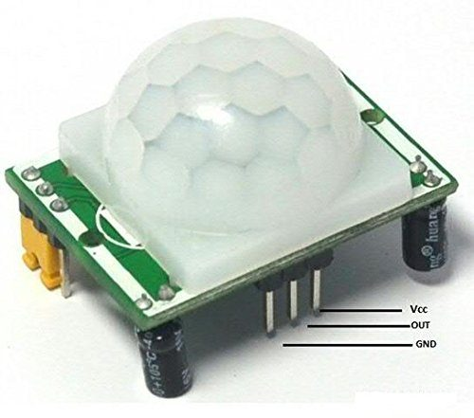
PIR Sensor
Detects motion by sensing infrared radiation.
Human bodies emit infrared energy.
When IR levels change, sensor outputs a signal.
Used in motion alarms and automatic lighting.

Slide 4
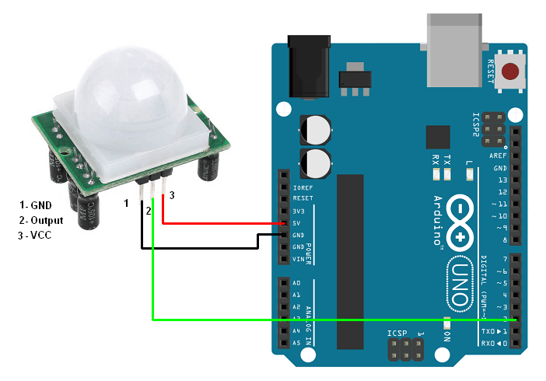
PIR Sensor Pins
GND – Ground connection for circuit completion.
VCC – Power supply input (5V).
Signal/OUT – Sends motion detection signal.
Signal becomes HIGH when motion is detected.

Slide 5
Circuit Connections
PIR GND → Arduino GND
PIR VCC → Arduino 5V
PIR Signal → Arduino Digital Input Pin
Optional: connect LED or buzzer for indication.

Slide 6

OVERALL SYSTEM

Slide 7
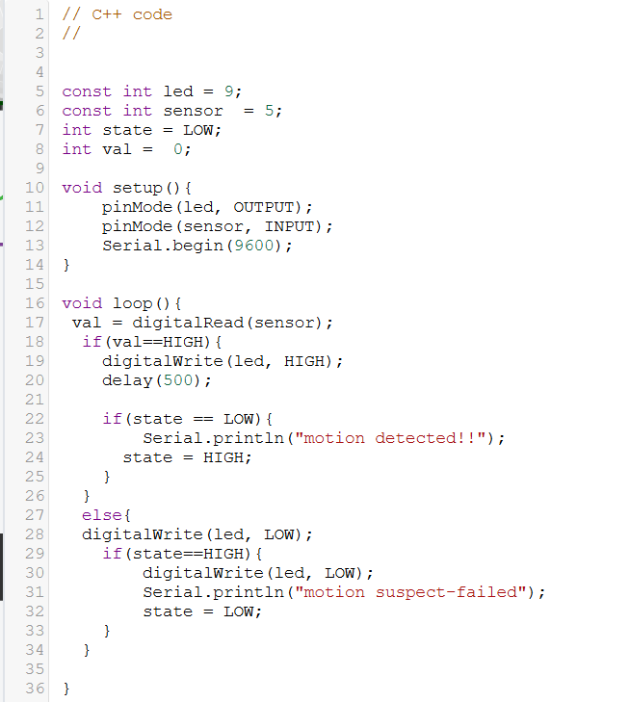
CODE.

Slide 8
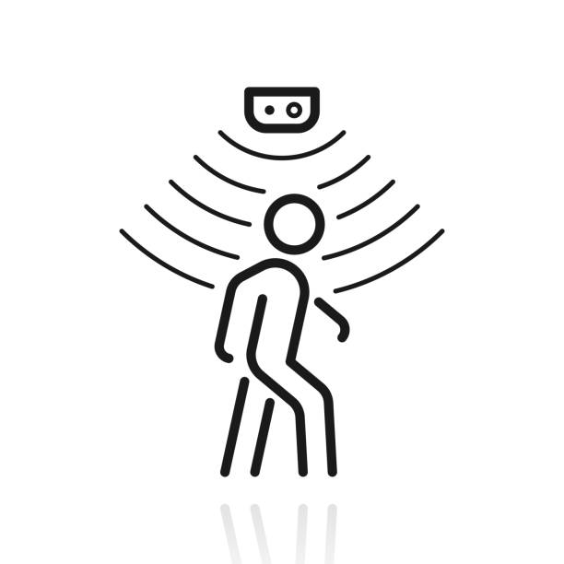
Working Principle
Sensor continuously monitors infrared radiation.
Movement causes change in IR pattern.
PIR outputs HIGH signal.
Arduino detects signal and triggers output.
Output shown via LED, buzzer, or display.

